Slide 1
Development Economics ECON 4915 Lecture 2
Andreas Kotsadam
Room 1038
Andreas.Kotsadam@econ.uio.no

Slide 2
Seminar on Monday
Will be held by Gry Østenstad.
Questions for seminar 1 (i.e. the seminar on Monday) are posted on the web.
Note that I have removed question 10.

Slide 3
Differentiation, maximization and shape of functions
f(L) = production function,
f’(L)>0
f’’(L)<0
Differentiation rules
Derivative
Concave function
Convex function

Slide 4
Outline
Discussion of the lecture plan.
Possible exam question and a recap.
What can be done to solve the credit problems?
Government intervention to expand credit (Burgess and Pande 2005).
Microfinance (Banarjee and Duflo 2010).

Slide 5
Migration vs. Natural Resources
Alternative 1: Keep Lecture 6 on immigration:
Ray Ch. 10; Mishra
Alternative 2: Discuss the curse of natural resources.
Overview article and an application (e.g. Mehlum, Moene, and Torvik 2006).

Slide 6
Typical exam question
1a) Theoretically, informal sector interest rates are very sensitive to the default risk even under perfect competition. Show this using the lender’s risk hypothesis, discuss the implications and relevance. (5 points)
1b) Give two examples of solutions to the information problems on the credit market that lead to poverty traps (2 points).

Slide 7
Recap (or more hidden exam questions?)
Credit rationing:
What is it?
Why does it occur, in particular, why doesn’t the lender just raise the interest to lend out more?
Explain intuitively how information asymmetries may cause credit rationing.

Slide 8
Policies
A nice (but not so simple) solution would be to build up good institutions and eliminate poverty.
In the meantime, we will discuss:
Government intervention to expand credit (Burgess and Pande 2005).
Microfinance (Banarjee and Duflo 2010).

Slide 9
Burgess and Pande (2005)
Research question: Do rural banks matter?
Interesting? Yes: Important topic (poverty), widespread policy and lots of theory.
Original? Yes: Credible evidence remains limited.
Feasible? Yes: By using policy rules as a source of exogenous variation and data exists.

Slide 10
The empirical problem
Bank expansion and economic growth are positively correlated in cross-country data.
Why do we need to know more?
Similarly, areas which have had state led expansion programs are poorer than other areas.
Evidence that state programs not working?

Slide 11
The policy
A branch expansion program introduced in 1977.
To obtain a license for a bank opening in a banked location, the bank must open branches in four unbanked locations as well.
This policy ended in 1990.

Slide 12
Data
State-level data.
Panel data on the number of banks, rural credit and saving shares.
The rural headcount ratio is the main poverty measure.

Slide 13
Why can’t we just run the following OLS regression?

Slide 14
Empirical strategy
Use the imposition and removal of the 1:4 branch licensing policy, as instruments.
Relevance: The policy must be a predictor for the number of banks.
Validity: The policy should not affect rural poverty in other ways than via the number of rural banks.

Slide 15
Relevance
Does the reform predict the number of banks?

Slide 16
Figure 1

Slide 17
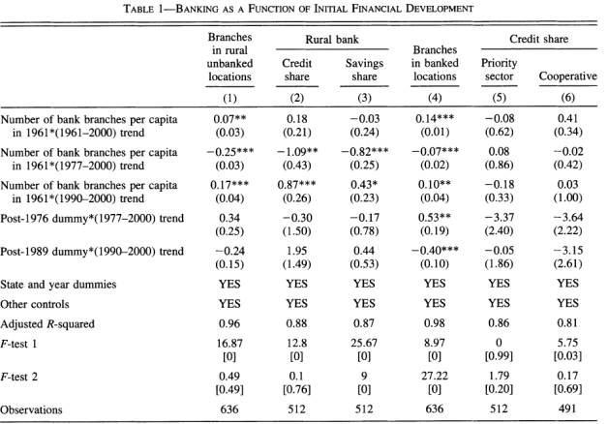
Testing the assumptions

Slide 18
Reduced form argument
We know that the trend breaks affected the number of banks…
… and they argue that that these breaks were exogenous.
Hence, they can look at the relationship between the trends and poverty.

Slide 19
Reduced form effects on poverty

Slide 20
IV argument
We know that the instruments are relevant…
… and they argue that they are valid.
Therefore they can be used to give us the effects of opening up banks in rural areas.

Slide 21
OLS vs IV results on poverty

Slide 22
Supporting evidence
The validity assumption is not testable, but arguments can be given for or against it.
What are the arguments against it and how do they account for these?

Slide 23
Their conclusion
“We provide robust evidence that opening branches in rural unbanked locations in India was associated with reduction in rural poverty.”

Slide 24
Critical questions
Have they really showed that rural banks matter or just that this policy had effects?
Does it matter that the bank openings were not randomly assigned?
Is the result generalizable to other contexts?
Do we know why the reform had an effect?
Was it cost effective?

